Slide 1


Slide 2
INTROSPECTION

Slide 3
Module Agenda
Finding Your WHY
Why LinkedIn
Figuring Out Your Niche

Slide 4
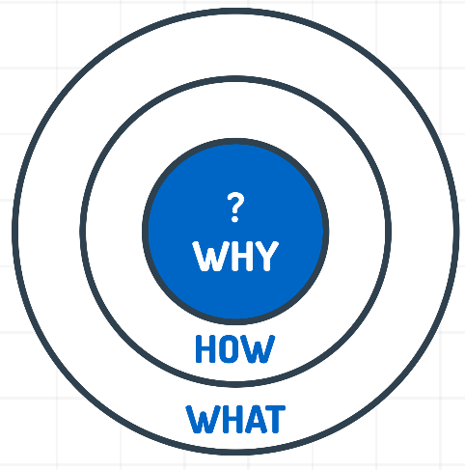
Finding Your WHY
“All of us know WHAT we do,
Some of us know HOW we do what we do,
And very few of us know WHY we do what we do.”
Because people don’t buy what we do,
they buy why we do it.
KNOW YOUR WHY
Simon Sinek’s Golden Circle

Slide 5
Finding Your WHY
Ask Yourself
Why do I want to create content?
What is my purpose and motivation?
What do I aim to get out of this?
Your WHAT and WHY are different things. Understand the nuances.

Slide 6

Brand Warikoo’s WHY
I believe choices in life should come from a point of awareness & not ignorance.
Your WHY is unique to you and it always remains the same.

Slide 7
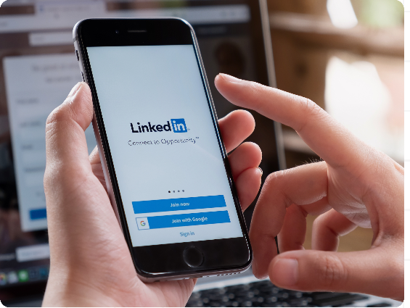

Why LinkedIn
for content creation?
Pause for a minute and give it a thought…

Slide 8
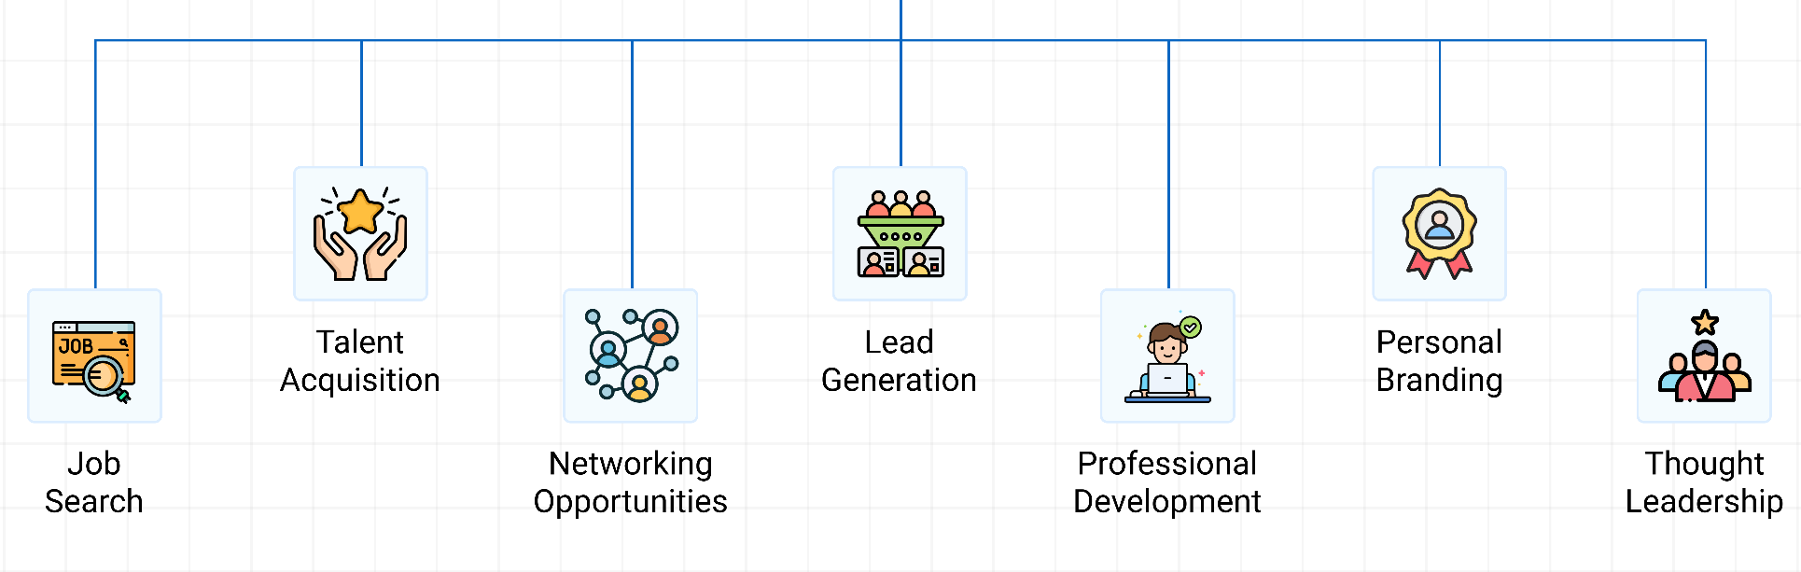
Why LinkedIn?
There’s more to LinkedIn than just job searching.

Slide 9
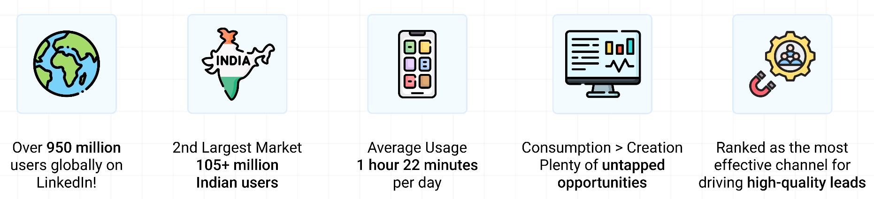
Why LinkedIn
Now is the best time to create content on LinkedIn

Slide 10
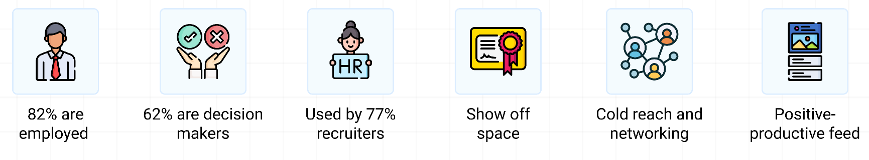
Why LinkedIn
LinkedIn vs other social media platforms: Quality of Audience

Slide 11
is the biggest arbitrage on social media today
Highest return to effort ratio

Slide 12
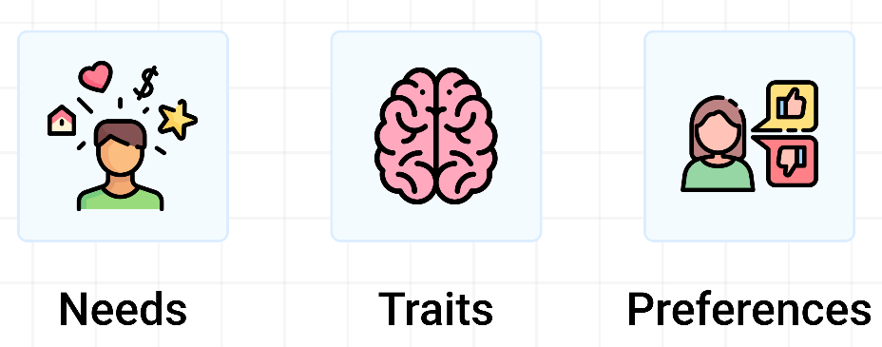
What Is Niche
A niche is a small and specific selection within a larger market, representing unique needs, traits, or preferences.

Slide 13
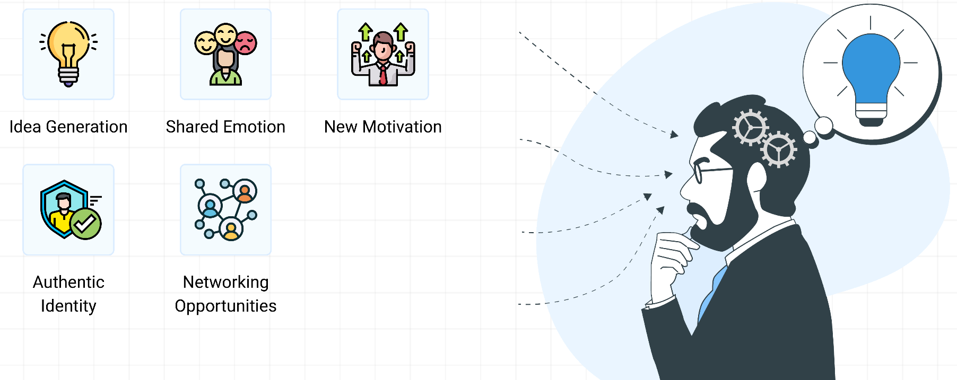
Why Should You Identify Your Niche?

Slide 14
